Slide 1
Search Engine for 2018 TREC Precision Data / Clinical Data
Divya Gandhi, Pooja Ghatge, Cai-Cian Song

Slide 2
Introduction
The precision medicine system is a system that is designed to represent the potential for connecting patients with experimental treatments and scientific research if existing treatments were ineffective.
Similar to precision medicine system our goal was to develop a search engine to fulfil the same goal.

Slide 3
Search problem
There are two kind of search problems depended on the data that is provided.
For Scientific Abstract
Search Problem: Retrieve relevant research for given Patient’s condition from the collection
For Clinical Trials
Search Problem: Retrieve relevant clinical trial for which the patient is eligible

Slide 4
What are the major inputs/outputs of the system?
Possible user Inputs:
1)disease name
2)symptoms
3)medical condition
4)gene name
Output:
Relevant scientific abstracts and clinical trials ranked according to an accurate metric
Search dataset:
Medline: medline_xml_part2
Clinical Trial: clinicaltrials_xml

Slide 5
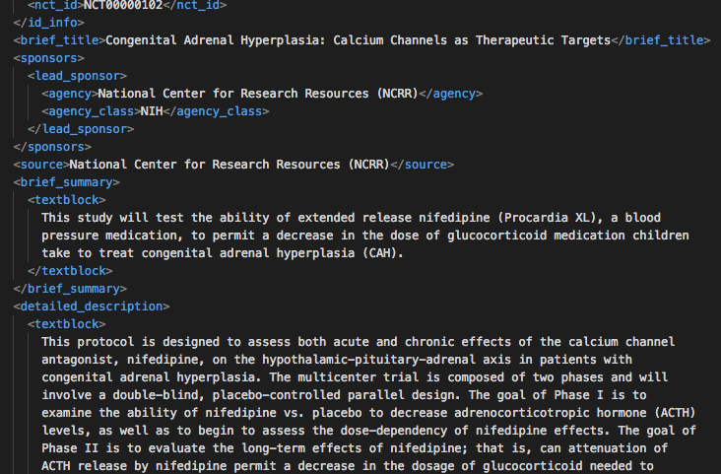
Clinical Trials XML
The clinical trials collection consisted of about 250,000 XML documents .
Each of these documents consisted of numerous fields, such as the title, summary, description, eligibility criteria, and some pre-assigned keywords and MeSH terms.
Each case describes the patient's disease (type of cancer), the relevant genetic variants (which genes), basic demographic information (age, sex), and other potential factors that may be relevant. 30 cases were made available for the retrieval task

Slide 6
Approach-Clinical Trials
Our approach makes use of the Elasticsearch search engine to index the available documents in the corpus.
The following fields were extracted from each clinical trial-> description: nct_id, brief_title, brief_summary, detailed_description, overall_status, condition, eligibility, gender, gender_based, minimum_age, maximum_age, keyword,and mesh_term.
The entire text in all the fields was used for the purpose of indexing.
After the indexing, the queries were run.

Slide 7
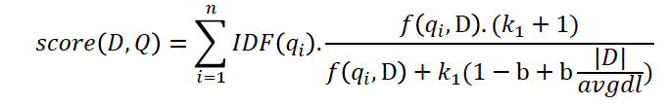
Elastic Search indexing
Before assigning scores to documents, they are shortlisted by applying a boolean test, so only the documents that match the query are considered.
Then scores are assigned based on a BM25 algorithm which is the default similarity algorithm used by Elasticsearch.
More about the algorithm-> This algorithm ranks a set of documents based on the query terms appearing in each document. where 𝑓(𝑞i, D) is qi’s term frequency in document D, |D| is the length of the document, and avgdl is the average document length in the corpus. k1 and b are the parameters of the algorithm. k1 controls non-linear term frequency normalization (saturation); default= 1.2 and b controls to what degree document length normalizes tf (term frequency) values(default 0.75).

Slide 8
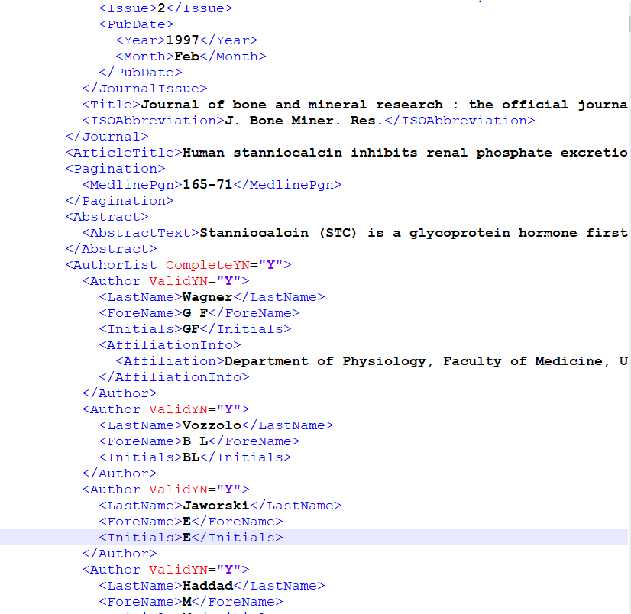
Scientific Abstracts XML
Data Size: medline_xml.part2.tar.gz [4.9 GB]
Files: 250 XML files of 207MB each.
Total pubmed articles indexed: 600,000 articles
Fields that were extracted from the XML files: Title, Abstract, Pubmed ID.
Information: The scientific abstracts contain information related to role of certain mutated genes in causing diseases.

Slide 9
Approach - Scientific abstracts
Preprocessing :
Articles with no abstracts are not indexed.
Fields that were ignored: publication date, author list, doi
Many relevant articles did not have ‘doi’, hence doi was not extracted.
The entire text from article and abstract is used.
Indexing : Elastic search
Retrieval and query formation:
Robust to spelling errors (FUZZINESS: AUTO)
Query time boosting: The documents which contain query terms in the title are given higher score than in abstract.

Slide 10
Thank You

